Slide 1

Data collection
a presentation by DR. L. PARIDA

Slide 2

Data Types
1 | primary
2 | secondary

Slide 3

INTRODUCTION
The data which are originally collected by an investigator or agency for the first time for any statistical investigation and used by them in the statistical analysis are termed as Primary data.
The data which have already collected and process by some agency person and taken over from there and used by any other agency for their statistical work are termed as Secondary data.

Slide 4

Method of collecting Primary data
Dr L. Parida

Slide 5
AREAS OF GROWTH
M1 | Direct personal Investigation
M2 | Indirect oral investigation
M3 | Informed received through local agencies
M4 | Mailed questionnaire method
M5 | Schedule sent through enumerators

Slide 6


Slide 7
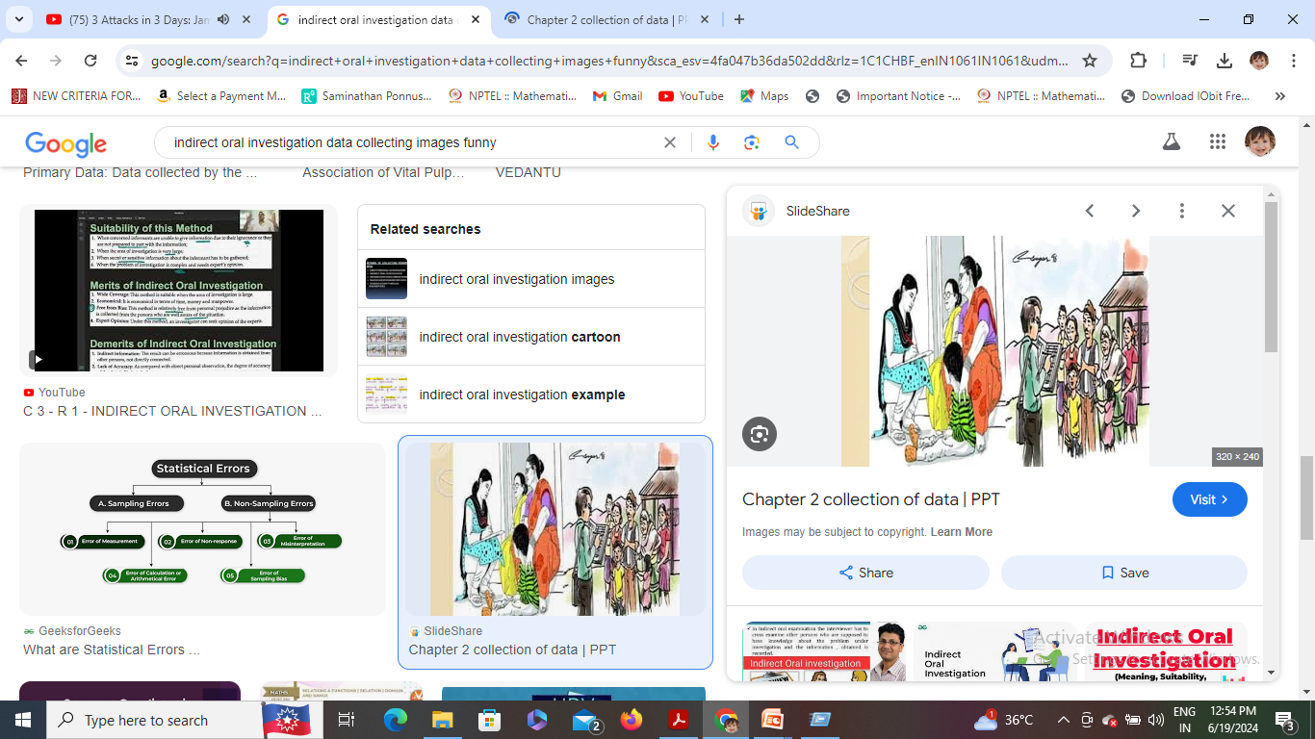
Indirect oral investigation

Slide 8

Informs receive through local agencies

Slide 9

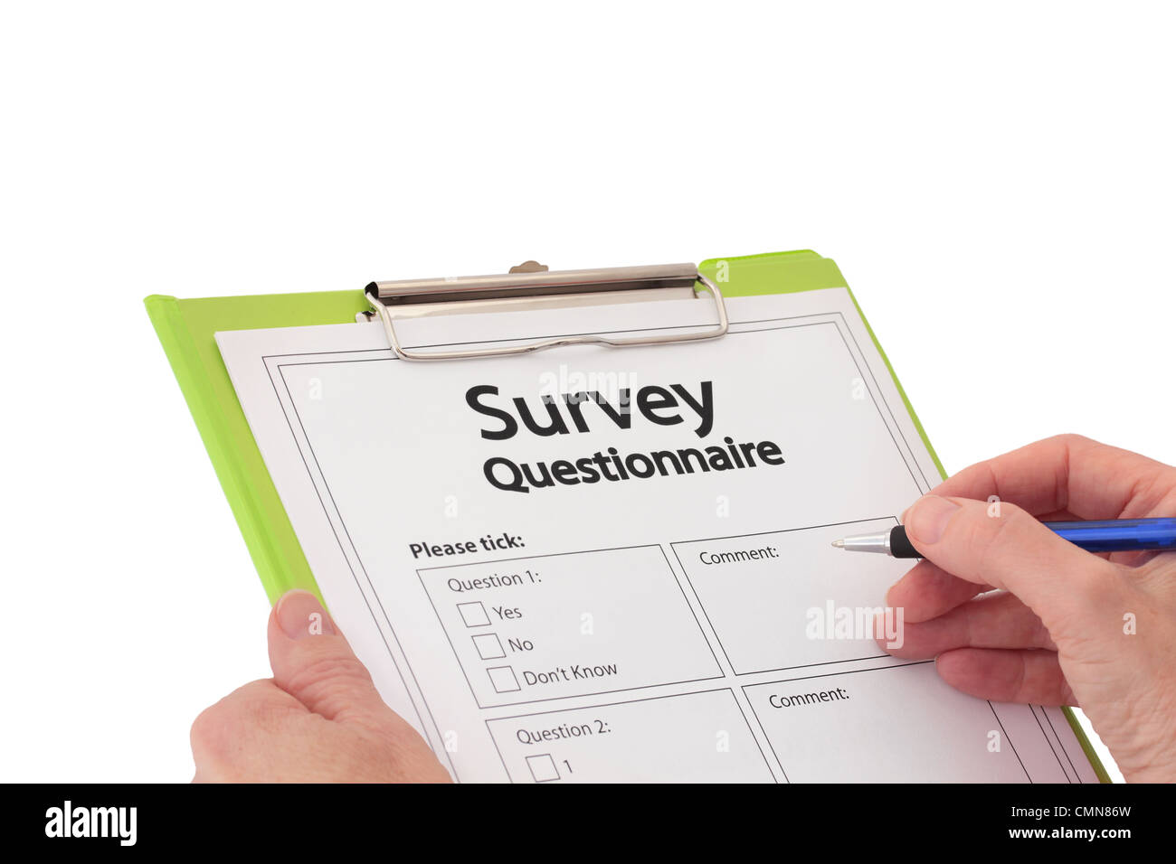
Mailed Questionnaire method

Slide 10
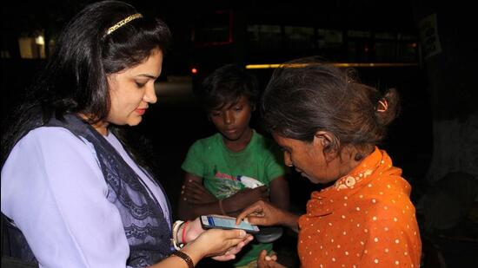
Schedules sent through the enumerations

Slide 11

Sources of secondary data
Dr L. Parida

Slide 12

THANK YOU
Dr. Laxmipriya Parida
Assistant professor
laxmipriya@giet.edu

